Slide 1


JOB MARKET ANALYSIS
PROJECT: PRDA – 04 Job Market Analysis
DATA ANAlysis & Visualization using SQL and Power BI
Prepared by: Pranjali Pawar

Slide 2
PROJECT OBJECTIVE
To analyze the Data Science job market and identify patterns in Job Availability, salaries, industries, companies, job titles, education and technical skills.
  Analyze job postings across different states.
  Compare minimum and maximum salaries by state.
  Identify industries with the highest number of job postings.
  Identify companies with maximum job openings.
  Identify the most in-demand job titles.
  Analyze salary according to education requirements.
  Analyze the skills required for different job titles.

Slide 3
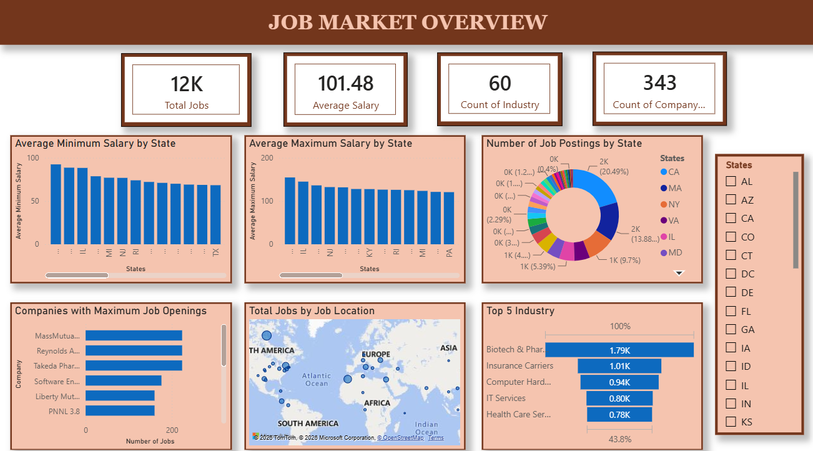
DATASET OVERVIEW
Total Features: 42
Data Source: MySQL Database
Visualization Tool: Power BI
  Job postings related to Data Science and related roles
  Approximately 12K job postings
  343 companies
  60 industries
  Salary, location, rating, sector, education and skill-related fields

Slide 4
DATA PREPARATION & TRANSFORMATION
The data was first analyzed and validated using MySQL.
SQL Analysis
Power BI Transformation
  Job postings by state
  Salary analysis by state
  Top industries
  Companies with maximum openings
  Job-title analysis
  Education and salary analysis
  Checked missing values
  Checked data types
  Checked unique values
  Prepared salary fields
  Prepared location/state information
  Prepared skill fields

Slide 5
DASHBORAD OVERVIEW
  The dataset contains approximately 12K job postings.
  Average salary displayed is 101.48.
  Job postings vary across states, companies and industries.

Slide 6
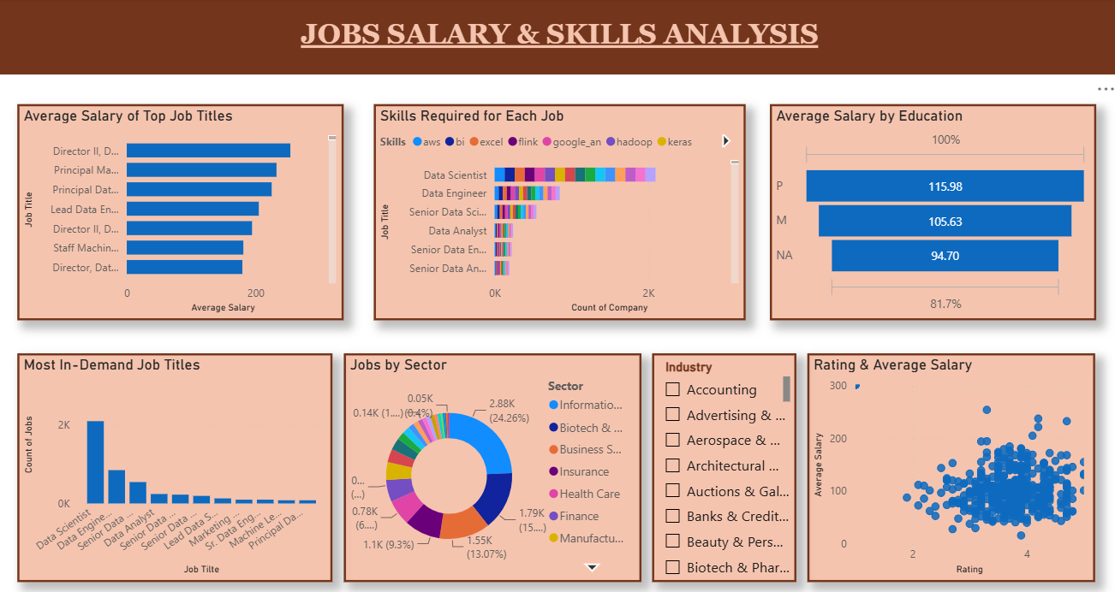
EMPLOYMENT TRENDS
  The dataset contains approximately 12K job postings.
  Average salary displayed is 101.48.
  Job postings vary across states, companies and industries.

Slide 7
STATE & SALARY ANALYSIS
Key observations
  The state-wise analysis shows differences in both job availability and salary levels across states.
  Average minimum and maximum salaries vary across states, indicating differences in salary ranges within the job market.
  Job postings are also unevenly distributed across states, with some states contributing a larger share of total postings.

Slide 8
INDUSTRY & COMPANY ANALYSIS
Key observations
  The analysis identifies the companies with the highest number of job openings and highlights the industries with the largest number of job postings.
  The job-title analysis shows that Data Scientist has the largest number of postings among the job titles displayed, followed by other roles such as Data Engineer and Data Analyst.
  Biotech & Pharmaceuticals has the highest posting count among the top five industries displayed.

Slide 9
RATING & SALARY ANALYSIS
The scatter plot shows the distribution of average salary across company ratings. The data points are spread across different rating and salary levels, indicating variation within the analyzed job postings.

Slide 10
SALARY & SKILLS ANALYSIS
Key observations
  The salary analysis shows differences in average salary across job titles.
  The skills analysis indicates that technical skills such as Python, SQL, AWS, Excel and other data-science-related technologies occur across job postings.
  The education analysis shows differences in average salary among the education categories present in the dataset.

Slide 11
KEY INSIGHTS
  Job Market
Approximately 12K job postings analyzed.
Data Scientist is the most frequently occurring job title displayed.
  Salary
Overall average salary: 101.48
Salary varies by state, job title and education category.
  Industry
Biotech & Pharmaceuticals has the highest posting count among the displayed top five industries.
Insurance Carriers and Computer Hardware also have substantial job-posting counts
  Skills
Multiple technical skills are required across Data Science-related roles.
  Education
Average salary differs across the education categories represented in the dataset.
  Companies
Job openings are concentrated among a subset of companies shown in the dashboard.

Slide 12
BUSINESS SUGGESTIONS
For Organizations
  Analyze location-wise job demand when planning recruitment.
  Monitor salary differences across roles and locations.
  Identify commonly required technical skills for hiring and training.
For Job Seekers
  Understand which job titles appear frequently in the analyzed market.
  Build skills that commonly appear across relevant job postings.
  Consider salary and location patterns when evaluating opportunities.

Slide 13
CONCLUSION
The Job Market Analysis project provides an overview of employment opportunities in Data Science and related fields.
SQL was used to retrieve, clean and transform the data, while Power BI was used to create interactive dashboards for analyzing job postings, salaries, companies, industries, job titles, education and skills.
The analysis demonstrates that job availability, salary levels, required skills and education requirements vary across different roles, industries and locations.
The dashboard provides a consolidated view of the job market and can be used to understand major patterns within the analyzed dataset.

